Slide 1
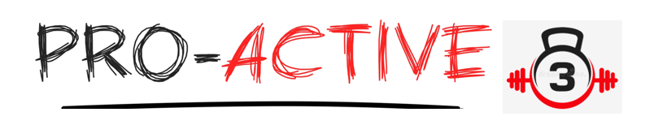
ProActive3 Company
Members:
Yael Karmani (220760047)
Gary (Lyndon) Reid (220546388)
Sopuruchi Owen (220143962)
Sotola olusegun ( 220275715 )

Slide 2
Table of Contents
Introduction - Yael
Why DevOps - Gary Lyndon Reid
Emerging Technologies - Gary Lyndon Reid
DevOps and ML - Sotola
Leveraging Managed Services in AWS - Sopuruchi Owen
Infrastructure as Code (IaC) - Yael
Expected Outcomes and Benefits - Gary Lyndon Reid

Slide 3
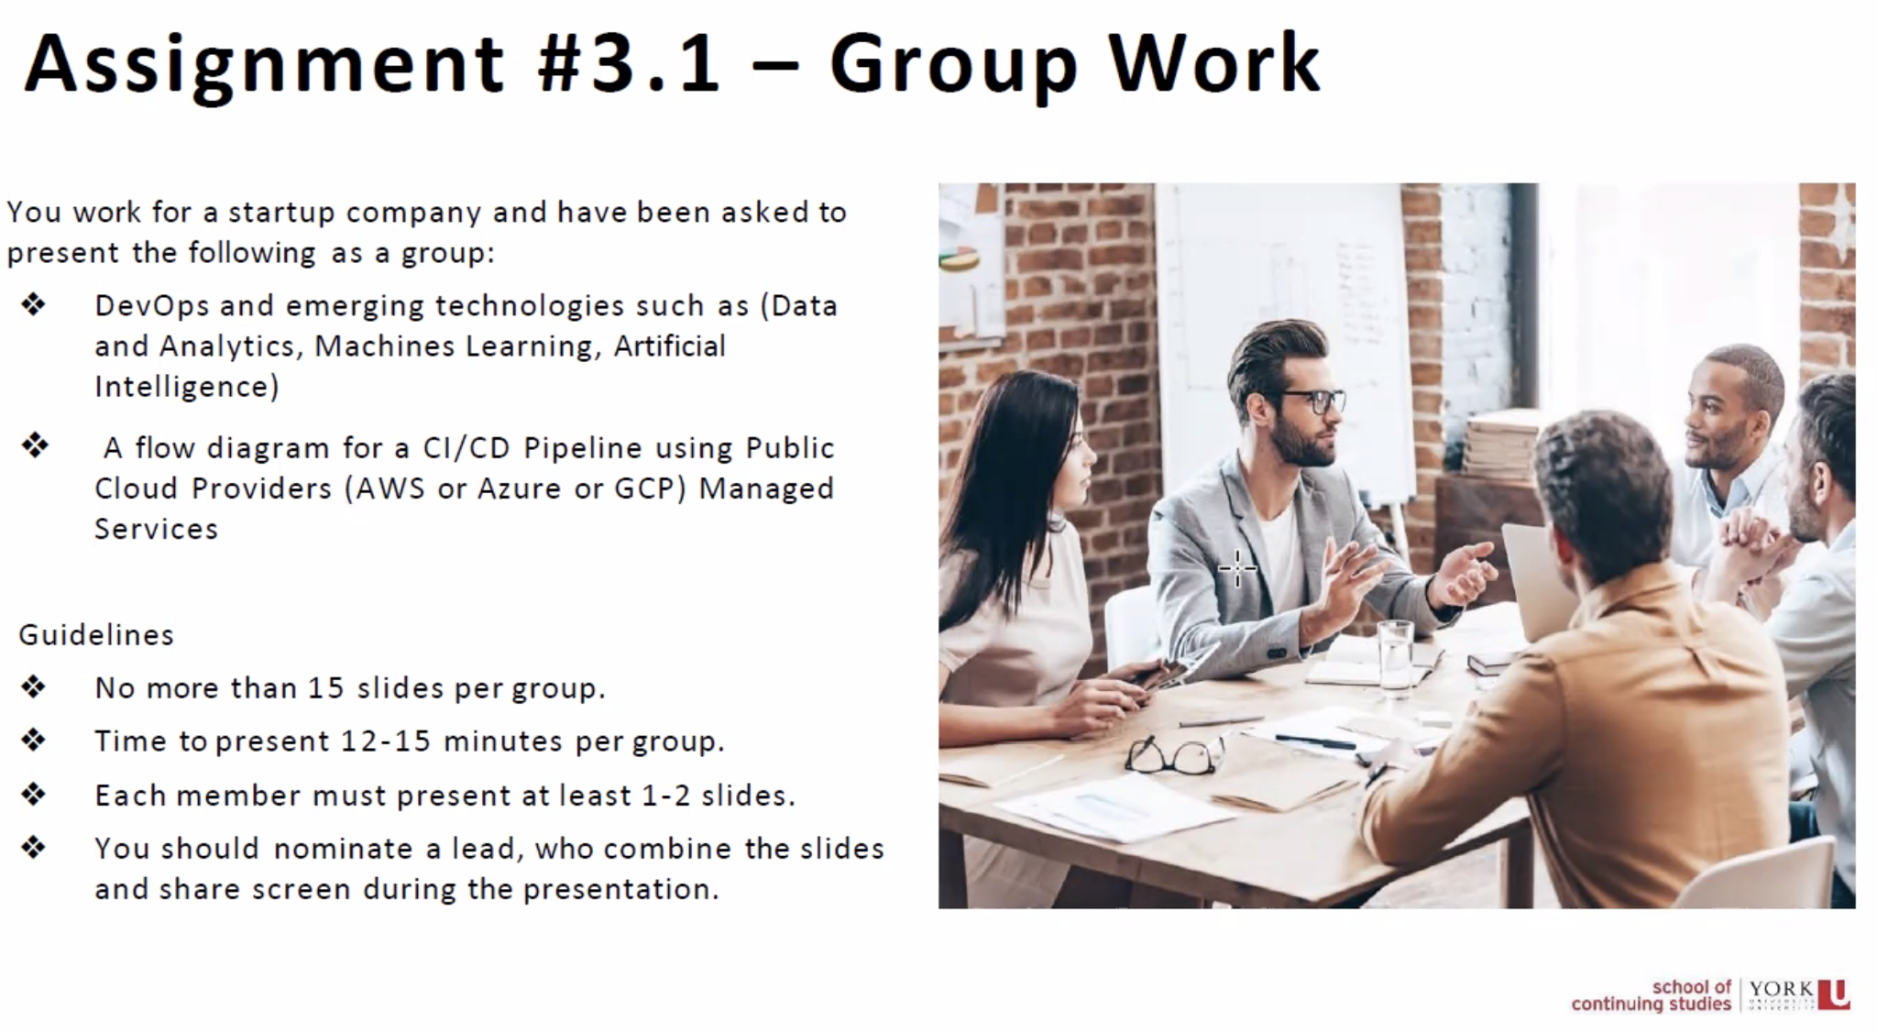
Table of Contents

Slide 4
Introduction with ProActive3 - Yael
Welcome to ProActive3, a leading AWS cloud platform software company dedicated to revolutionizing the fitness industry through innovative app development and a user-centric gym portal.
We specialize in creating intuitive applications that empower gym users to manage their workout schedules, track progress, and achieve their fitness goals effectively.
Our comprehensive provides valuable information about gym locations, opening hours, available facilities,progress, goles achievement, menu plan, and expert online tutors for personalized consultations. With our technology, we aim to enhance the fitness experience and inspire individuals on their health and wellness journey - Online and all the time.
At ProActive3, we have wholeheartedly embraced the DevOps philosophy and principles, recognizing its potential to transform the software development lifecycle
Notes:
Welcome to ProActive3- software company revolutionizing in the fitness industry through innovative app and user portal.

Slide 5
Why DevOps - Lyndon Reid
Increased Velocity
Embracing Devops principles and practices and creating a modern CI/CD pipeline will allow our company to ship features to production quickly.
Increased Quality
We will leverage automated tests which will allow us to reduce defects. Futher more our ability ship features quickly will allow us to remediate issues FAST!
Increased Availability
Many DevOps practices will be implemented including monitoring and instrumentation, feature toggling, canary deployments, and blue/green deployments. The culmination of these practices will result in ProActive 3 finally hitting their availability targets of 99.99%.
Increased Customer Satisfaction
Increased velocity and quality and our ability to respond to customers quickly will result in happy customers.
Notes:
Background A summary of the company, its history, and its goal

Slide 6
Why DevOps - Lyndon Reid
Improved Collaboration
By adopting a DevOps culture we will break down organizational silos and our developers, operations, and security teams will work closely together.
Reduced Cost
The unit cost to deliver features will be reduced, and the amount of time addressing issues such as environmental challenges will also be reduced unlocking developers to focus on shipping features.
Decreased Risk exposure
By embracing DevSecOps we will reduce our exposure to risk. We will work closely with security throughout the development lifecycles and we will implement SCA, SAST, and DAST tooling as part of our multistage CICD pipelines.
Notes:
Background A summary of the company, its history, and its goal

Slide 7
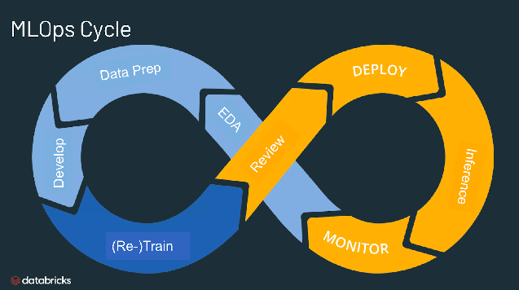
Emerging Technologies - Lyndon Reid
AIOps
AIOps allows us to unlock the power of our data and take advantage of AI to improve our operations
Collect large amounts of data from logs and use AI to analyze and inform
Use historical data to predict future outcomes
Sift through datasets and identify anomalies that cause performance and stability issues
Heal and remediate issues automatically
MLOps
MLOps refers to the practice of implementing DevOps principles in the Machine Learning Space
Optimize the process of deploying Machine Learning models to production
Optimize the maintenance and the monitoring of the models
Collaboration between Engineers, Data Scientists, and Operations

Slide 8
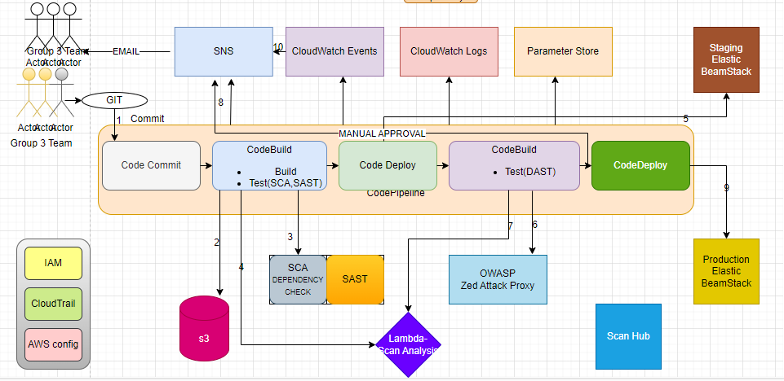
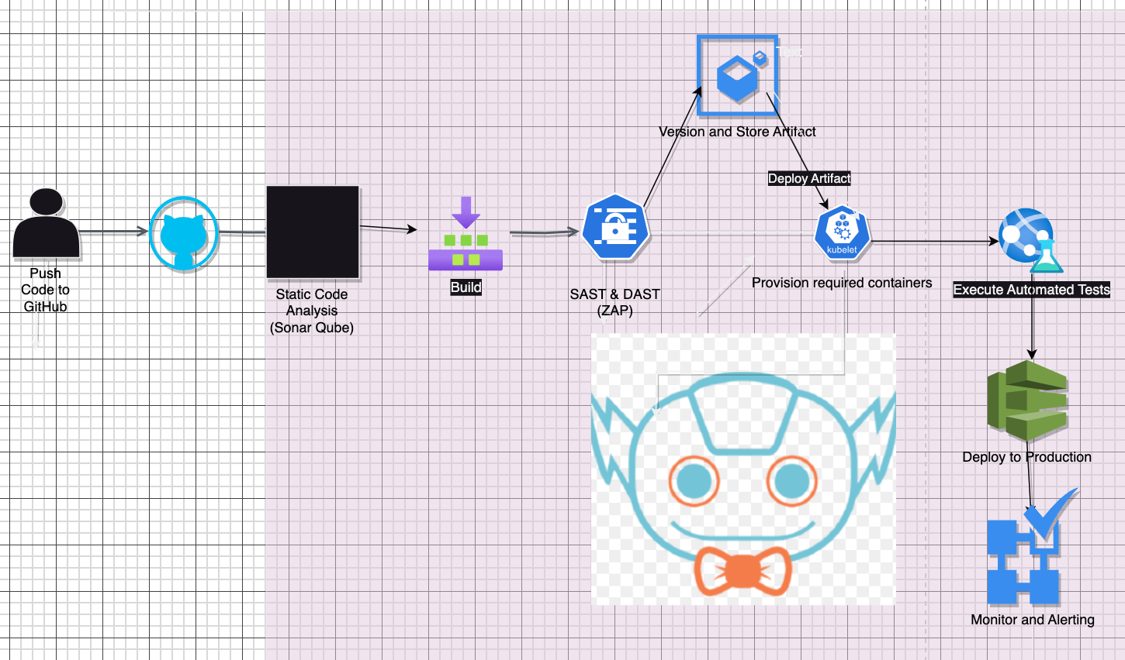
CI/CD pipeline Modernization Solution Overview
Notes:
CI/CD pipeline Modernization Solution Overview A high-level overview of the CI/CD pipeline solution is to be built-in in support of the business case requirement

Slide 9
Summary:Devops and MLops blended solutions by PROACTIVE 3 - Sotola
ProActive3 Company have been able to build a powerful synergy between DevOps and Machine Learning (ML) and related capabilities, like Predictive Analytics, IT Operations Analytics (ITOA), Algorithmic IT Operations (AIOps), and Artificial Intelligence (AI). As this is the next genaration of automation and building application with predictiive inteligence,
Devops and MLops blended solutions have achieved the following solutions:
1, Tracking application delivery: Activity data from ‘DevOps tools’ (like Jira, Git, Jenkins, SonarQube, Puppet, Ansible, etc.) provides visibility into the delivery process. Applying ML can uncover anomalies in that data — large code volumes, long build times, slow release rates, late code check-ins — to identify many of the ‘wastes’ of software development, including gold-plating, partial work, inefficient resourcing, excessive task switching, or process slowdowns.
2,Ensuring application quality: By analyzing output from testing tools, ML can intelligently review QA results, detect novel errors, and effectively build a test pattern library based on discovery. This machine-driven understanding of a ‘known good release’ helps to ensure comprehensive testing on every release, even for novel defects, raising the quality of delivered applications.
3,Securing application delivery: Patterns of user behavior can be as unique as fingerprints. Applying ML to Dev and Ops user behaviors can help to identify anomalies that may represent malicious activity. For example, anomalous patterns of access to sensitive repos, automation routines, deployment activity, test execution, system provisioning, and more can quickly highlight users exercising ‘known bad’ patterns — whether intentionally or accidentally — such as coding back doors, deploying unauthorized code, or stealing intellectual propert

Slide 10
Devops and MLops blended solutions by PROACTIVE 3
4,Managing production: Analyzing an application in production is where machine learning really comes into its own, because of the greater data volumes, user counts, transactions etc. that occur in prod, compared to dev or test. DevOps teams can use ML to analyze ‘normal’ patterns user volumes, resource utilization, transaction throughput, and subsequently to detect ‘abnormal’ patterns (e.g. DDOS conditions, memory leaks, race conditions,
5,Managing alert storms: A simple, practical, high-value use of MLops is in managing the massive flood of alerts that occur in production systems. This can be as simple as ML grouping related alerts (e.g. by a common transaction ID; a common set of servers; or a common subnet). Or it can be more complex, such as ‘training’ systems over time to recognize ‘known good’ and ‘known bad’ alerts. This enables filtering to reduce alert storms and alert fatigue.
6,Preventing production failures: MLops can go well beyond straight-line capacity planning in preventing failures. ML can map known good patterns of utilization to predict, for example, the best configuration for a desired level of performance; how many customers will use a new feature; infrastructure requirements for a new promotion; or how an outage will impact customer engagement. ML sees otherwise opaque ‘early indicators’ in systems and applications, allowing Ops to start remediation or avoid problems, much faster than typical response times.

Slide 11
Devops and MLops blended solutions by PROACTIVE 3
7,Analyzing business impact: Understanding the impact of code release on business goals is critical to success in DevOps. By synthesizing and analyzing real user metrics, MLops systems can detect good and bad patterns to provide an ‘early warning system’ to coders and business teams alike when applications are having problems (e.g. through early reporting of increased cart abandonment or foreshortened buyer journeys); or being wildly successful (e.g. through early detection of high user registrations or click-through rates).

Slide 12
CI/CD Pipeline:For ProActive3 Using AWS Managed Services - Owen
Leveraging AWS managed services for CICD Pipeline will handle
AWS CodeCommit: Fully managed source code version control service like GitLab
Provided us a secure and scalable hosting for private Git repository to store our source code/files from our Developers
This also allowed us to collaborate as a team while working on this project and Integrates with other AWS services
AWS CodeBuild: Fully managed build service like Jenkins for OSS
Compiled our source code from our Developers, runs tests, and produces software artifacts/Product/Package
Offered us a scalable build environments and integrates with popular build tools.
AWS CodeDeploy:Automates application deployments to various compute services.
Supports different deployment strategies like rolling updates and blue/green deployments.
Enables easy rollback options and integrates with other AWS services.
Notes:
Assumptions A list of the assumptions you made in relation to the provided cases study.

Slide 13
CI/CD Pipeline:For ProActive3 Using AWS Managed Services
AWS CodePipeline: Fully managed continuous delivery service.
Orchestrates the steps of your CI/CD pipeline.
Integrates with various AWS services, including CodeCommit, CodeBuild, and CodeDeploy.
AWS Elastic Beanstalk: Fully managed service for deploying and managing applications.
Handles infrastructure provisioning, load balancing, auto-scaling, and monitoring.
Supports multiple programming languages and frameworks.
AWS Lambda: Serverless compute service.: Allows you to run code without provisioning or managing servers.
Enables event-driven architectures and easy integration with other AWS services.
Notes:
Improvement Opportunities Identify the potential areas of opportunity for improvements or an existing problem that the company has that needs DevOps practices and CI/CD Pipeline; you could utilize the Value Stream Mapping (VSM).

Slide 14
CI/CD Pipeline:For ProActive3 Using AWS Managed Services
Infrastructure-as-Code (IaC) service.: Automates provisioning and management of AWS resources using templates.
Allows for consistent and repeatable infrastructure deployments.
AWS CloudWatch: Monitoring and observability service.
Collects and tracks metrics, generates alarms, and provides log management.
Offers insights into the performance and health of your applications and infrastructure.
AWS Step Functions:
Serverless workflow orchestration service.
Helps coordinate and visualize multiple AWS services into a workflow.
Allows for building complex, stateful workflows and integrations.
Notes:
Improvement Opportunities Identify the potential areas of opportunity for improvements or an existing problem that the company has that needs DevOps practices and CI/CD Pipeline; you could utilize the Value Stream Mapping (VSM).

Slide 15
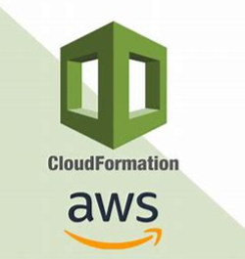
Infrastructure as Code (IaC) - Yael
At ProActive3, we utilize AWS CloudFormation as a key component of our DevOps practices to streamline the deployment and management of our infrastructure. AWS CloudFormation enables us to define our infrastructure requirements as code and provision AWS resources in a consistent and repeatable manner.
By embracing AWS CloudFormation, we streamline our infrastructure provisioning, management, and updates. With infrastructure defined as code, we ensure consistency, scalability, and repeatability across different environments. Our adoption of CloudFormation as an integral part of our DevOps practices enables us to deliver reliable and efficient solutions to our users while maintaining agility and scalability in the ever-evolving fitness industry.

Slide 16
Expected Outcomes
Increased Availability
In 2023 YTD we have achieved 96.6%. We forecast achieving 99.7% in 2024, and 99.9% in 2025.
Increased Velocity
In 2022 we released to production 18 times. Or an average of 1.5x times per month. In 2024 we expected to achieve weekly releases and be Q2 2025 we anticipate having a continuous deployment capabilities for all of of Digital Crown applications.
Improved MTTR
Failures are inevitable. In 2023 it’s taken us an average of 18 hours to restore service. We anticipate reducing this to 2 hours in 2024 due to improved instrumentation and the ability to quickly rollback changes.
Increased Revenue
The ability to ship more, increased stability and performance, and faster feedback loops will ultimately result in increased revenue. The 2017 State of DevOps report by DORA indicated that publicated traded companies who embrace devops saw the Market Capitalization grow by 50% more than their peers.

